Slide 1
Checkpoint introduction to Database
AMOR BETTAYEB

Slide 2
SQL? NoSQL?
SQL is a programming language; however, it is not a general-purpose programming language like Java, JavaScript, or Python. Instead, SQL follows a specific purpose: to access and manipulate data. To be more precise, SQL stands for Structured Query Language. It is a query language that allows retrieving specific data from databases, and, in that sense, it is designed to access, store and manipulate relational databases | NoSQL refers to non-relational databases and to distributed databases. NoSQL can also stand for "Not Only SQL" to highlight that some NoSQL systems may also support SQL query language. In fact, before moving on, it is important to keep in mind that NoSQL does not necessarily mean that a database does not support SQL. Instead, it means that the database is not an RDBMS. While traditional RDBMS rely on SQL syntax to store and query data, on the other hand, NoSQL database systems use other technologies and programming languages to store structured, unstructured or semi-structured data.

Slide 3
VS
SQL | NoSQL
Relational Database Management System (RDBMS) Compatible with many tools Best suited for complex queries Table-based database Predefined schema Vertically Scalable | Non-relational database system Faster than SQL Best suited for simple queries Collection-based database Unstructured/dynamic shema Horizontally scalable

Slide 4

MongoDB
MongoDB (link resides outside IBM) is an open source, non relational
database management system (DBMS) that uses flexible documents
instead of tables and rows to process and store various forms of data. As a
NoSQL solution, MongoDB does not require a relational database
management system (RDBMS), so it provides an elastic data storage model
that enables users to store and query multivariate data types with ease. This
not only simplifies database management for developers but also creates
a highly scalable environment for cross-platform applications and services.

Slide 5
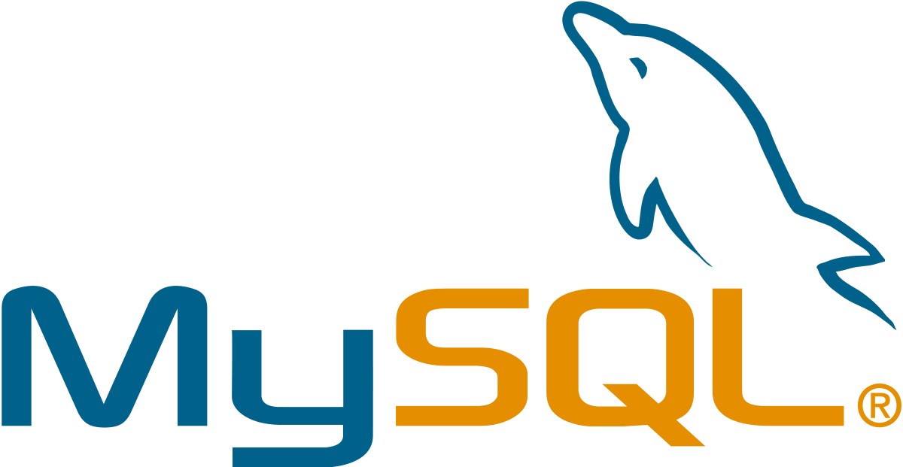
MySQL
MySQL is a relational database management system (RDBMS). It is distributed under a dual GPL and proprietary license. It is one of the most used database management software in the world3, both by the general public (mainly web applications) and by professionals, in competition with Oracle, PostgreSQL and Microsoft SQL Server.
MySQL is an SQL relational database server developed with high read performance in mind, which means it's geared more towards serving the data that's already in place than frequent, highly secure updates. It is multi-threaded and multi-user.
It is free, open source software, developed under a dual license depending on whether it is distributed with a free product or with a proprietary product.

Slide 6

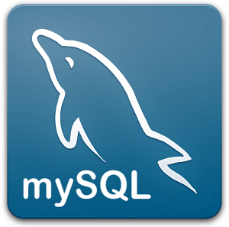
VS
MongoDB | MySQL
Relational Database MongoDB is an open-source database developed by MongoDB, Inc. MongoDB stores data in JSON-like documents that can vary in structure. It is a popular NoSQL database. In MongoDB, each individual records are stored as ‘documents’. Documents belonging to a particular class or group as stored in a ‘collection’. Example: collection of users. | MySQL is a popular open-source relational database management system (RDBMS) that is developed, distributed and supported by Oracle Corporation. In MySQL, each individual records are stored as ‘rows’ in a table. A ‘table’ is used to store rows (records) of similar type.

